Slide 1
Development Concepts – Current Screen
Concept 1 – Independent BB & Elepa B/Ls from Elepa to BFCL Gas Plant - Base Case
BB
37.5km
BFCL Gas Plant at Akabel
30km
Elepa
Concept 2 - Common BB & Elepa B/L from Elepa T to BFCL Gas Plant
BB
BFCL Gas Plant at Akabel
9km
Common M/F
28.5km
1.5km
Elepa

Slide 2
Base Case Development Concept Options
Concept 1 – Independent BB & Elepa B/Ls from Elepa to BFCL – Concept Options
Base Case Option 1A: BB F/Ls to BB’s M/F at Elepa & Elepa F/Ls to Elepa’s M/F at Elepa
BB
Well 1
8’’ 9km F/L
BB
Field M/F
8’’ 9km F/L
Gas Plant
BB
Well 2
8’’ 9km F/L
Gas
Processing Facilities
Train-1: 125 MMscfd
Train-2: 125 MMscfd
Train-3: 125 MMscfd
Fertilizer
Plant
BB
Well 3
NAG Wells Gas Flow – 250 MMscfd
Gas
16’’ x 28.5km B/L
BB/Elepa Interconnectivity Provision
12’’ x 0.1km B/L
In-plant Interconnecting Line
Elepa
Well 1
6’’ 2.5km F/L
HGOR Wells Multiphase Flow – 125 MMscfd
Gas
Elepa
Well 2
12’’ x 28.5km B/L
6’’ 2.5km F/L
Power
Plant
Elepa
Well 3
6’’ 2.5km F/L
6’’ 2.5km F/L
Elepa
Field M/F
Elepa
Well 4
6’’ 2.5km F/L
Elepa
Well 5
Condensate
Storage Tanks
Condensate
6’’ x 0.5km
Condensate
Export Jetty
8’’ x 17km
Brass
Terminal

Slide 3
Base Case Development Concept Options
Concept 1 – Independent BB & Elepa B/Ls from Elepa to BFCL – Concept Options
Option 1B: BB B/L to BB’s M/F at Elepa & Elepa F/Ls to Elepa’s M/F at Elepa
BB
Well 1
8’’ 1km F/L
BB
Field M/F - 1
BB
Field M/F - 2
8’’ 1km F/L
Gas Plant
BB
Well 2
8’’ 1km F/L
16’’ x 8km B/L
Gas Processing Facilities
Train-1: 125 MMscfd
Train-2: 125 MMscfd
Train-3: 125 MMscfd
Fertilizer
Plant
BB
Well 3
NAG Wells Gas Flow – 250 MMscfd
Gas
16’’ x 28.5km B/L
BB/Elepa Interconnectivity Provision
12’’ x 0.1km B/L
In-plant Interconnecting Line
Elepa
Well 1
6’’ 1km F/L
HGOR Wells Multiphase Flow – 125 MMscfd
Gas
Elepa
Well 2
12’’ x 28.5km B/L
6’’ 1km F/L
Power
Plant
Elepa
Well 3
6’’ 1km F/L
6’’ 1km F/L
Elepa
Field M/F
Elepa
Well 4
6’’ 1km F/L
Condensate
Storage Tanks
Condensate
Elepa
Well 5
6’’ x 0.5km
Condensate
Export Jetty
8’’ x 17km
Brass
Terminal

Slide 4
Base Case Development Concept Options
Concept 1 – Independent BB & Elepa B/Ls from Elepa to BFCL – Concept Options
Option 1C: BB F/Ls to BB Field M/F & Elepa F/Ls to Elepa Field M/F
BB
Well 1
8’’ 1km F/L
BB
Field M/F
8’’ 1km F/L
Gas Plant
BB
Well 2
8’’ 1km F/L
BB
Well 3
Gas
Processing Facilities
Train-1: 125 MMscfd
Train-2: 125 MMscfd
Train-3: 125 MMscfd
Fertilizer
Plant
NAG Wells Gas Flow – 250 MMscfd
Gas
16’’ x 37.5km B/L
BB/Elepa
Interconnectivity Provision
In-plant Interconnecting Line
12’’ x 8km B/L
HGOR Wells Multiphase Flow – 125 MMscfd
Gas
Elepa
Well 1
12’’ x 30km B/L
6’’ 1km F/L
Power
Plant
Elepa
Well 2
6’’ 1km F/L
6’’ 1km F/L
Elepa
Field M/F
Elepa
Well 3
6’’ 1km F/L
6’’ 1km F/L
Condensate
Storage Tanks
Elepa
Well 4
Condensate
Elepa
Well 5
6’’ x 0.5km
Condensate
Export Jetty
8’’ x 17km
Brass
Terminal

Slide 5
Other Case Development Concept Options
Concept 2 - Common BB & Elepa B/L from Elepa T to BFCL – Concept Options
Option 2A - BB Flowlines & Elepa Flowlines to Elepa T M/F
BB
Well 1
BB
Well 2
8’’ 9km F/L
8’’ 9km F/L
Gas Plant
BB
Well 3
8’’ 9km F/L
Gas
Processing Facilities
Train-1: 125 MMscfd
Train-2: 125 MMscfd
Train-3: 125 MMscfd
Fertilizer
Plant
Gas
Elepa T M/F
6’’ 2.5km F/L
20’’ x 28.5km B/L
Elepa
Well 2
6’’ 2.5km F/L
6’’ 2.5km F/L
Gas
6’’ 2.5km F/L
6’’ 2.5km F/L
Elepa
Well 3
Power
Plant
Elepa
Well 4
Elepa
Well 5
Elepa
Well 1
Condensate
Storage Tanks
Condensate
6’’ x 0.5km
Condensate
Export Jetty
8’’ x 17km
Brass
Terminal

Slide 6
Other Case Development Concept Options
Concept 2 - Common BB & Elepa B/L from Elepa T to BFCL – Concept Options
Option 2B - BB B/L & Elepa B/L to Elepa T M/F
BB
Well 1
8’’ 1km F/L
BB
Field M/F
8’’ 1km F/L
Gas Plant
BB
Well 2
8’’ 1km F/L
BB
Well 3
Gas
Processing Facilities
Train-1: 125 MMscfd
Train-2: 125 MMscfd
Train-3: 125 MMscfd
Fertilizer
Plant
Gas
16’’ x 9km B/L
Elepa T M/F
20’’ x 28.5km B/L
Elepa
Well 1
Gas
Elepa
Well 2
6’’ 1km F/L
12’’ x 1.5km B/L
6’’ 1km F/L
Power
Plant
Elepa
Well 3
6’’ 1 km F/L
6’’ 1km F/L
Elepa
Field M/F
Elepa
Well 4
6’’ 1km F/L
Condensate
Storage Tanks
Condensate
Elepa
Well 5
6’’ x 0.5km
Condensate
Export Jetty
8’’ x 17km
Brass
Terminal

Slide 7
Other Case Development Concept Options
Concept 2 - Common BB & Elepa B/L from Elepa T to BFCL – Concept Options
Option 2C - BB B/L & Elepa F/Ls to Elepa T M/F
BB
Well 1
8’’ 1km F/L
BB
Field M/F
8’’ 1km F/L
Gas Plant
BB
Well 2
8’’ 1km F/L
16’’ x 8km B/L
BB
Well 3
Gas
Processing Facilities
Train-1: 125 MMscfd
Train-2: 125 MMscfd
Train-3: 125 MMscfd
Fertilizer
Plant
Gas
Elepa T M/F
6’’ 2.5km F/L
20’’ x 28.5km B/L
Elepa
Well 2
6’’ 2.5km F/L
6’’ 2.5km F/L
Gas
6’’ 2.5km F/L
6’’ 2.5km F/L
Elepa
Well 3
Power
Plant
Elepa
Well 4
Elepa
Well 5
Elepa
Well 1
Condensate
Storage Tanks
Condensate
6’’ x 0.5km
Condensate
Export Jetty
8’’ x 17km
Brass
Terminal

Slide 8
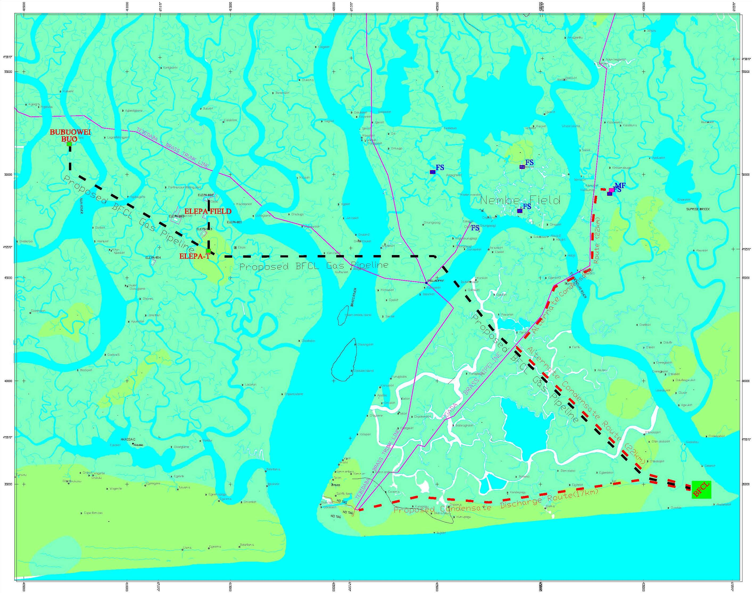
Selected Pipeline Route

